Slide 1
7 TYPES OF DATA STORIES
Xiaolan Li

Slide 2
The data source is from kaggle: https://www.kaggle.com/szamil/who-suicide-statistics

Slide 3
1. CHANGE OVER TIME

Slide 4
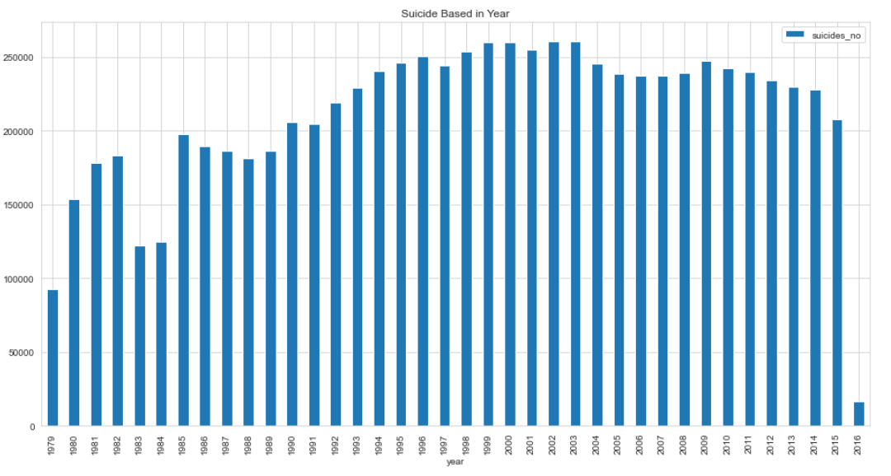
CHANGE OVER TIME
Question: How does the global number of suicides change from year to year?
Answer: Using who-suicide-statistics data, we could tell a change over time data from 1979 to the begining of 2016 by looking at the total suicide numbers in the world, the number is high and still climbing over time. There is no downward trend from the data.
New question: What about individual countries

Slide 5
2. DRILLING DOWN

Slide 6
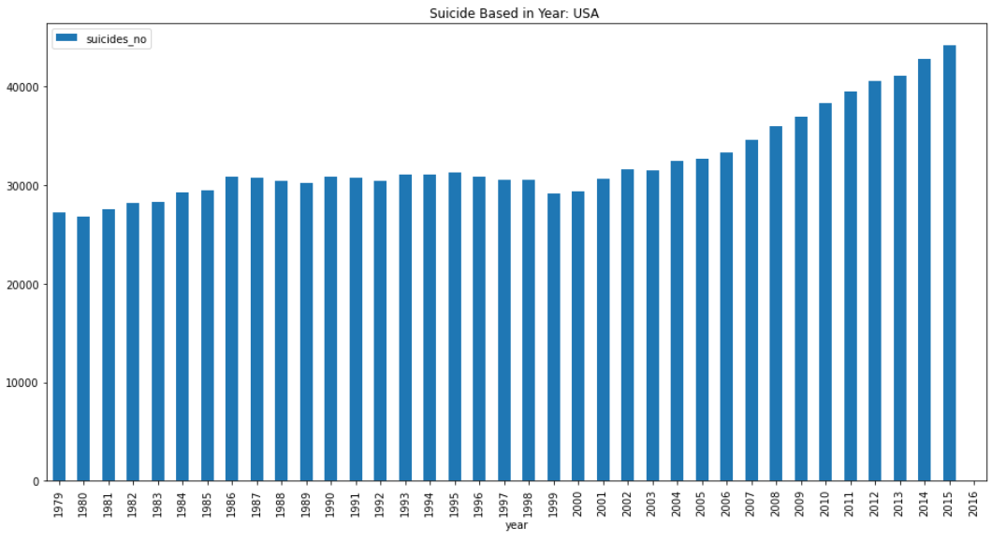
DRILLING DOWN
Question: How does the number of suicides in the USA change from year to year?
Drilling down into the data, we can look at how the number of suicide from 1985 to 2015 differs between groups. (For example, country of the USA) the number is high and still climbing over time year by year.
New question: Is the number of Suicides in the United States high or low globally?

Slide 7
3. ZOOMING OUT

Slide 8
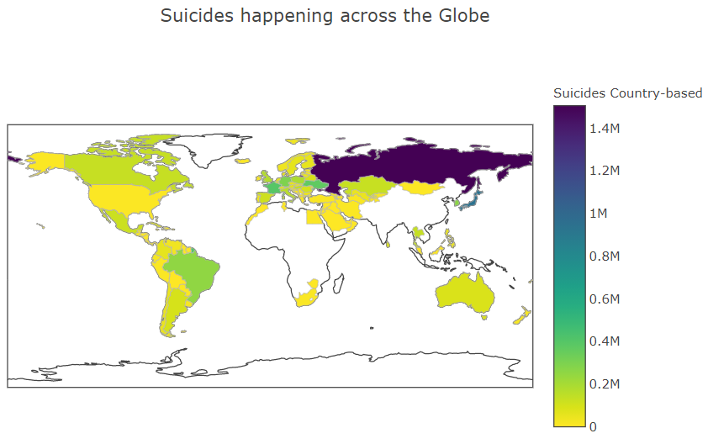
ZOOMING OUT
Question: Is the number of Suicides in the United States high or low globally?
We can apply this data story technique to our data to learn whether the suicide number in the US is better or worse than average . By using data from other countries to zoom out, we can show the data in a wider context. The USA suicide number is moderate in the world. We can tell the Russia is highest in the world.
New question: What other attributes are associated with suicide rates?

Slide 9
4. CONTRAST

Slide 10
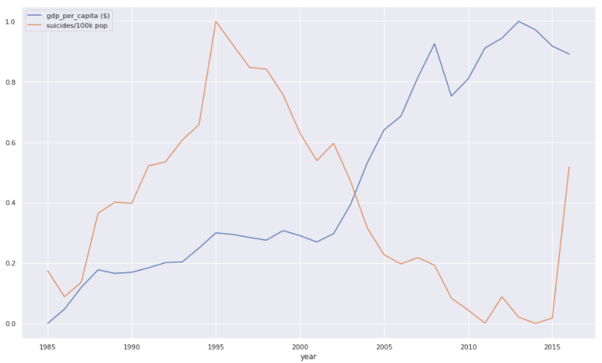
CONTRAST
Question: What other attributes are associated with suicide rates
Using our data, we can tell a contrast story about how the rate of suicide relates to country GDP per capita. By combining the GDP per capita data, we can see when a country GDP per capita is higher, the suicide rate is lower and vice versa.
New question: Whether the age changes over time, the suicide rate changes?

Slide 11
5. INTERSECTIONS

Slide 12
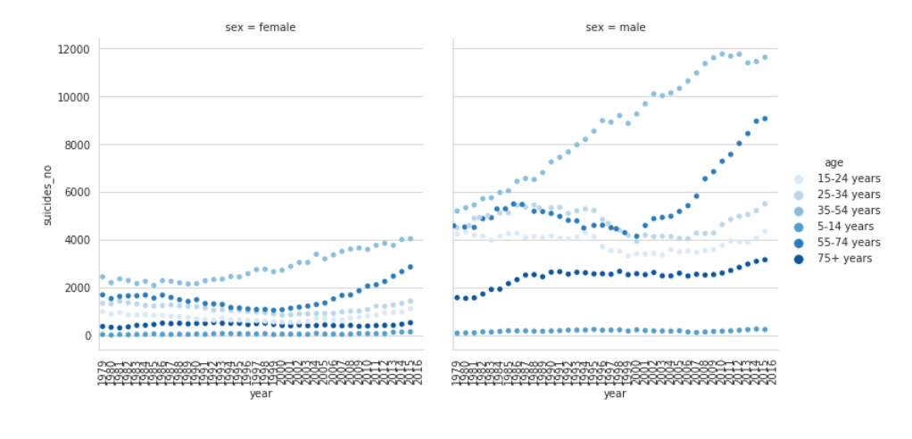
INTERSECTIONS
Question: Whether the age changes over time, the suicide rate changes?
We can create an intersection story using our data to convey the complex way variables interact to tell a more interesting story. We’ve created a narrative about how age influence the likelihood a suicide. The example shows how age affects the suicide number in the world. As can be seen from the chart with male gender, the 55-74 age group has been higher than the 25-34 age group since the 21st century and the trend of growth is getting bigger and bigger.
New question: What factors are responsible for the number of suicides?

Slide 13
6. FACTORS

Slide 14
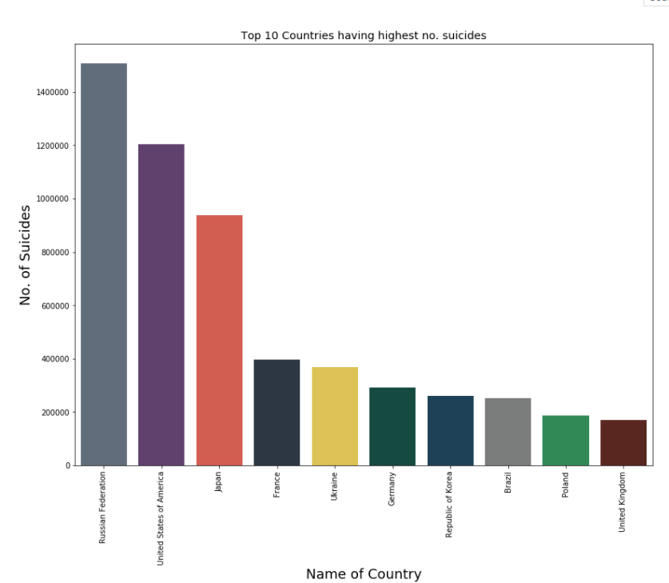
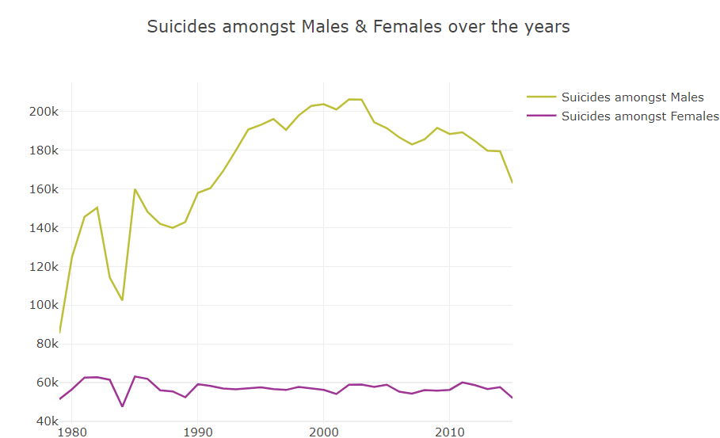
FACTORS
Question: What factors are responsible for the number of suicides?
We could tell a factor story with the data by examining the fact that country and gender to be a powerful factor in determining the number of suicide. As we can see from the chart, Russia has the highest suicide rate and united states is the second. In addition, suicide rates are generally higher among men than women.
* New question: Are there any outliers to be further explored?

Slide 15
7. OUTLIERS

Slide 16
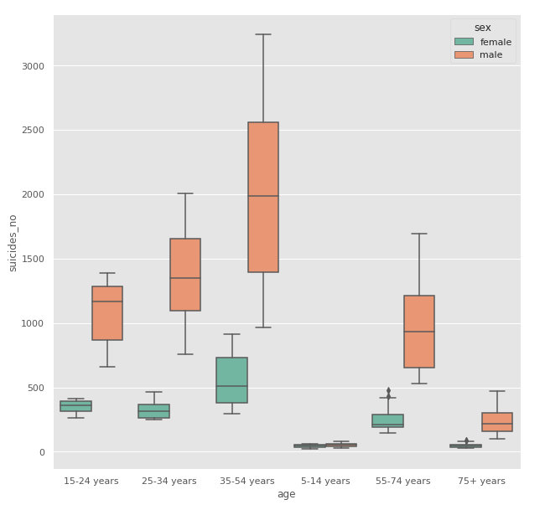
OUTLIERS
Question: Are there any outliers to be further explored?
After break it down by regions in a box plot, we can tell the 55-74 years group female box plot has some outliers. This outliers may be the useful data to explore why there is a outlier in that group.

Slide 17
Thank You For Watching !

